Slide 1
Annual Work Plan & Budget Mid Day Meal Scheme 2018-19
Education Department
Government Of Gujarat

Slide 2
Index
Introduction
State Government Initiative
Progress of MDM for year 2017-18
Annual Work Plan & Budget 2018-19
Recommendation

Slide 3
Introduction
Gujarat introduced MDM scheme in 1984 and is pioneer state in providing fresh, hot and nutritious meal during the day to children between the age group of 6 to 14 years, i.e. standard 1 to 8.
Total 34307 Schools are Covered by MDM
43.97 lakh Beneficiaries
96,329 Cook cum Helpers
Budget sanctioned for 2017-18 is Rs. 1068 Crores
Central Share Rs. 435.36 Cr
State Provision Rs. 632.45 Cr

Slide 4
State Government Initiatives
Two Time Meal
Sukhadi Project
Dudh Sanjivani Yojana
Tithi bhojan
Anna Triveni Yojana
Centralized Modern Kitchen In MDM
Website /Mobile Application for AMS and Data collection

Slide 5
TWO TIME MEAL
As per the guideline of Mid Day Meal to provide 450 calories and 700 calories we were giving 180 gram (primary) and 265 gram (upper primary) food grains.
When this food grain is cooked its weight becomes almost double of the food grain approximately 400 grams.
The students of Primary and Upper Primary can't take this much food intake at a time.
After care full consideration Government has decided to divide meal into two parts (1) Breakfast (2) Lunch
so that children have increase protein & calories level.

Slide 6
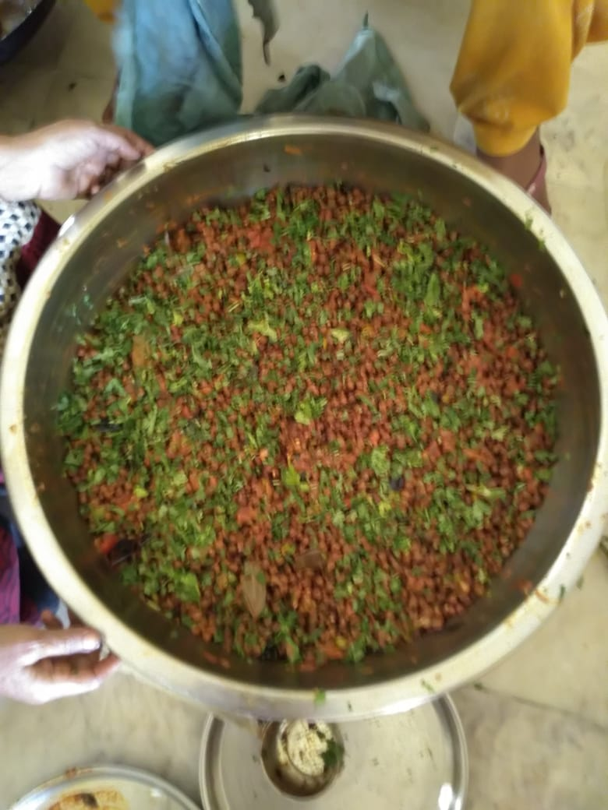
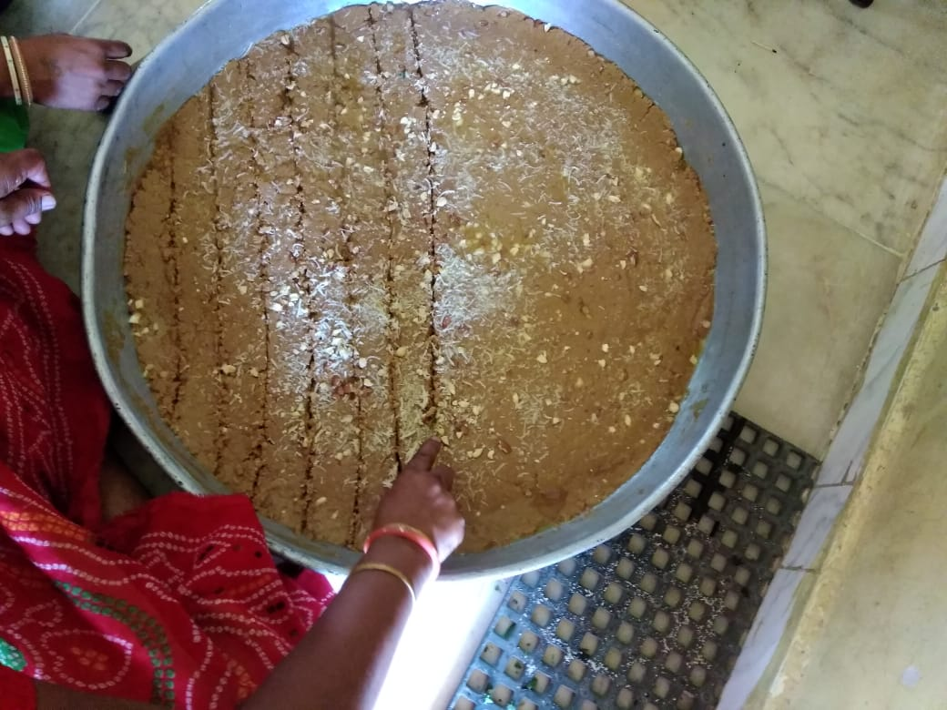
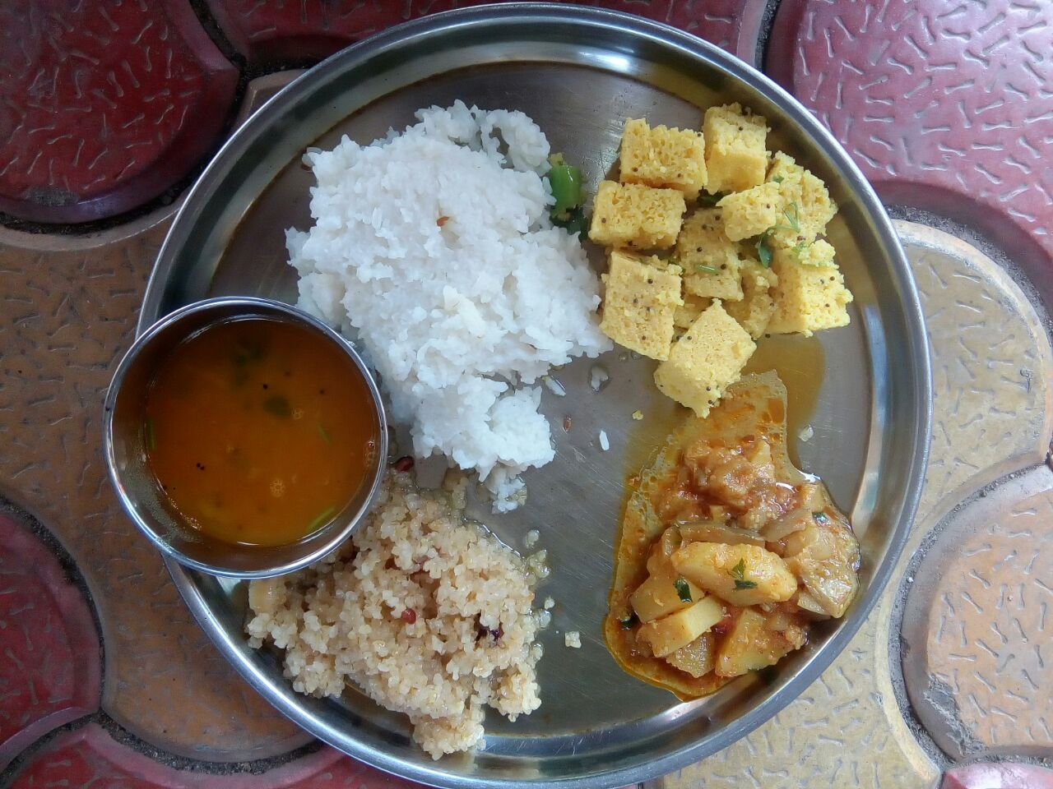
WEEKLY MENU
DAY | BREAK FAST | LUNCH
Monday | Sukhdi | Vegetable khichdi
Tuesday | Chana Chat | Thepala & Sukhi Bhaji
WednesDay | Mix Dal/ Usal | Vegetable Pulav
Thursday | Chana Chat | Dal Dhokli
Friday | Muthiya | Dal-Bhat
Saturday | Chana Chat | Vegetable Pulav

Slide 7
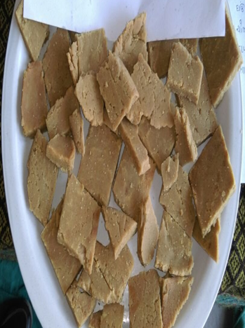
SUKHDI
It aims to enhance calorie and protein intake by students.
Sukhdi recipe is being served once a week and is approved by the CFTRI (Central Food Technological Research Institute) & nutrition experts
It is prepared using wheat, jaggery and oil.
Provision of Rs. 3827.55 lakh has been made in 2017-18

Slide 8
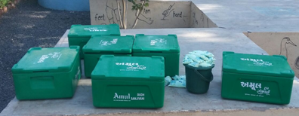
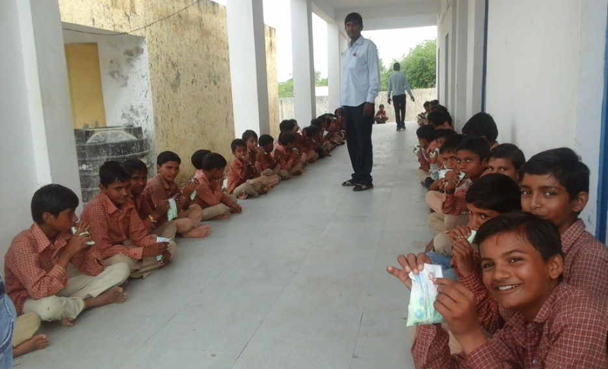
DUDH SANJIVANI YOJANA -Milk in MDM
In this scheme 200 ml. flavored milk is served 5 days in a week to primary school children.
Currently 26 blocks of 12 Districts get the benefit of this scheme
MDM centers : 3748
Beneficiary : 4.81 lakh
Provision : 90 crore in 2017-18

Slide 9
Tithi bhojan -An approach with Community participation
Birth The State Government has initiated the concept of Public Participation in the scheme through the concept of “TithiBhojan”.
The Villagers sponsor the food with sweets for children on various occasions and provide utensil for MDM centers.
It is customary in Gujarat to host public dinner on festival days or social occasions like
Marriage anniversary
Birth Anniversary
Death anniversary
Any special occasion like any educational or social achievement like ranking first in school, promotion etc.

Slide 10
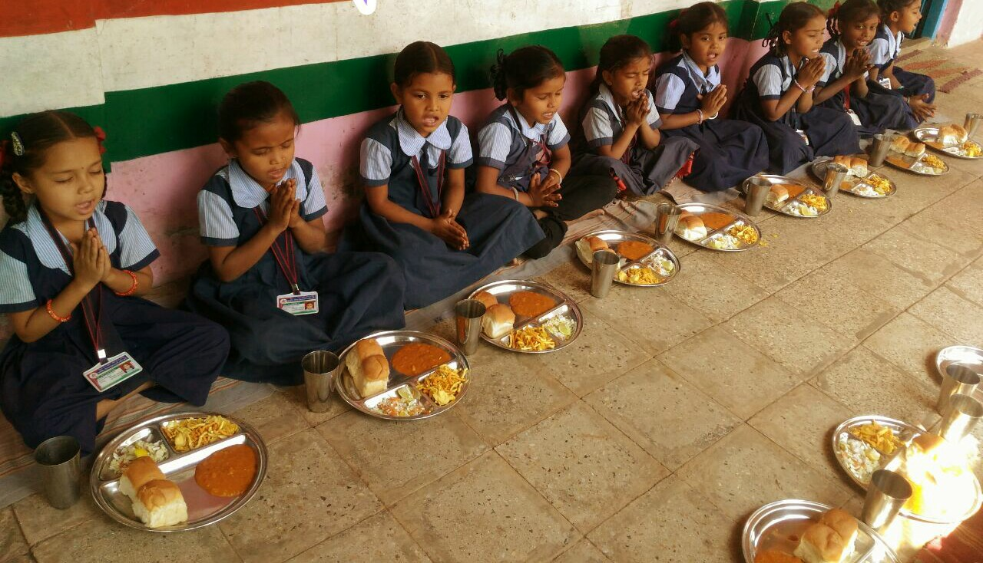
How Tithi Bhojan Yojana works
In each village people are educated for this Yojana Sarpanch of gram panchayat, political leaders, social leaders, principal of the school, economically rich people in the community gives contribution in Tithi Bhojan Yojana.
Per month at least 5 to 10 Tithi Bhojan donors are listed in each village.

Slide 11
Contribution Of Donars In Tithibhojan Yojana
Donars give either total cost of one day Meal in cash
Sometimes, they give one sweet like laddu, sukhdi, shrikhand etc.
They give milk /fruits.
They give farsan /namkeen
They donate utensils which are used in MDM
They donate RO plant / Water cooler /Fan in school

Slide 12
Impact or Benefits
It reduces MDM cost.
Social Benefits & Impacts.
Supplementation of the nutritional value of MDM food.
Development of rapport with the local community.
Inculcating the feeling of equity and brotherhood among the children of all communities.
Reduction of the gap between the school administration and the community.
This is also reflected in form of enhancement of the enrolment and regular attendance of the children at the school.

Slide 13
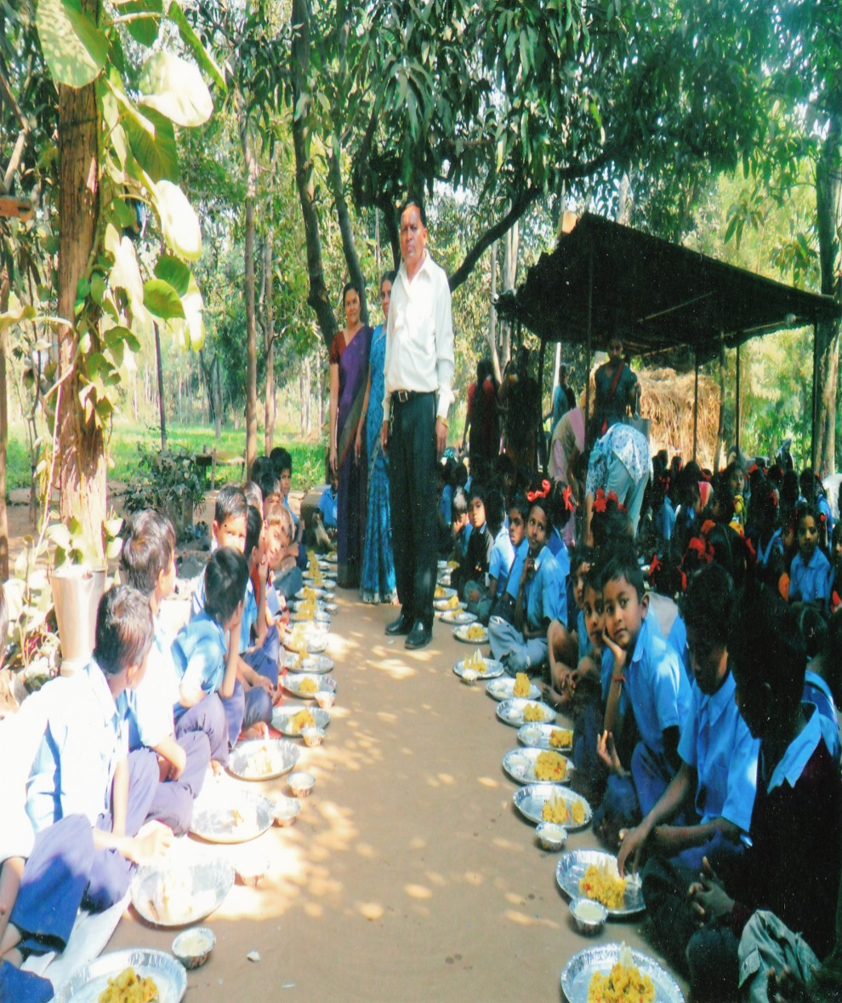
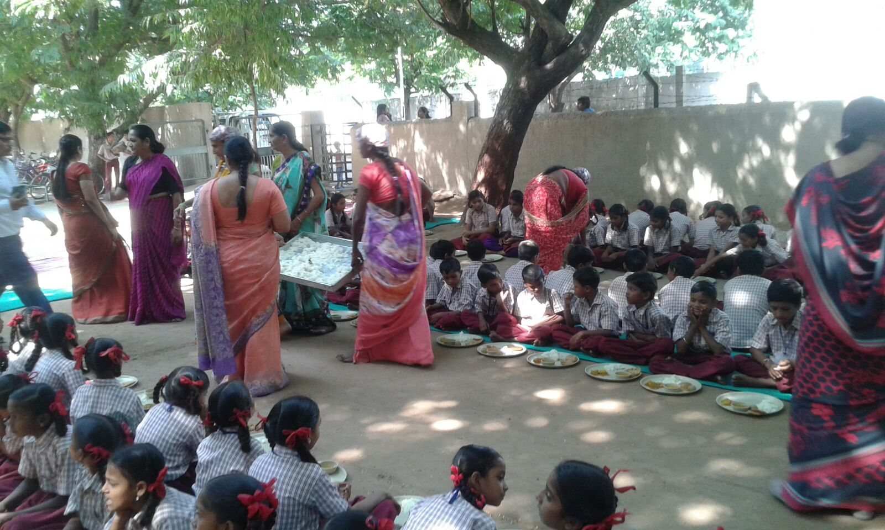
Tithi Bhojan by Community Participation

Slide 14
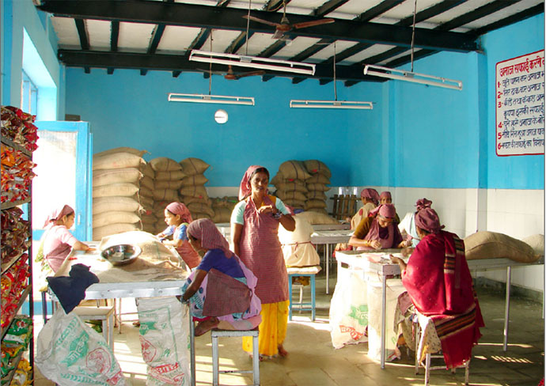
“ ANNA TRIVENI YOJANA” - Free food grain to Tribal Girls under Mid Day Meal
Benefit of the scheme is given to the tribal girls whose attendance is more then 70% during the term.
This benefit is extended for the two tribal girls in the family.
60kg (per term 30 kg) food gains (10kg wheat,10kg Rice,10kg Corn) is given to the tribal girls.
Provision :Rs.76 crore in year 2017-18
Criteria : must have more than 70 % annual attendance

Slide 15
Centralized Modern Kitchen in MDM
The aim and objective of the program has been to achieve universalization of elementary education be enhancing enrollment, retention and attendance and improving the nutritional status and quality of education.
At present three NGO namely Stri Shakti, Akshaya Patra Foundation & Nayak Foundation are serving cooked food under the MDM Scheme from their centralized kitchen in 7 districts, 3327 schools.

Slide 16
Centralized Modern Kitchen in MDM
Sr. | Organization | Area served | Centers | Beneficiary in Lakhs
1 | Akshayapatra | Corporations of Ahmedabad (W),Bhavnagar, Surat and Vadodara Gandhinagar (3 blocks) Ahmedabad rural (1 block), Vadodara (3 blocks) | 1555 | 357215
2 | Nayak Foundation | Navasari District | 740 | 72164
3 | Stree Shakti | Corporations of Ahmedabad (E) and Rajkot, Valsad (4 blocks) | 1032 | 108621
Total |  |  | 3327 | 538000

Slide 17
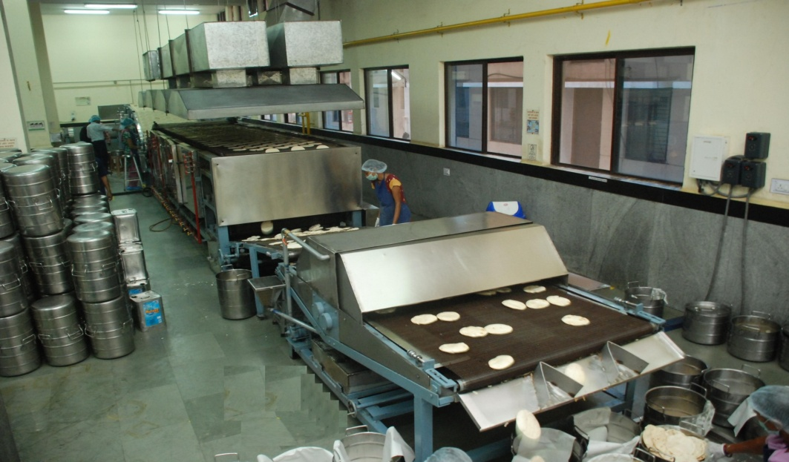
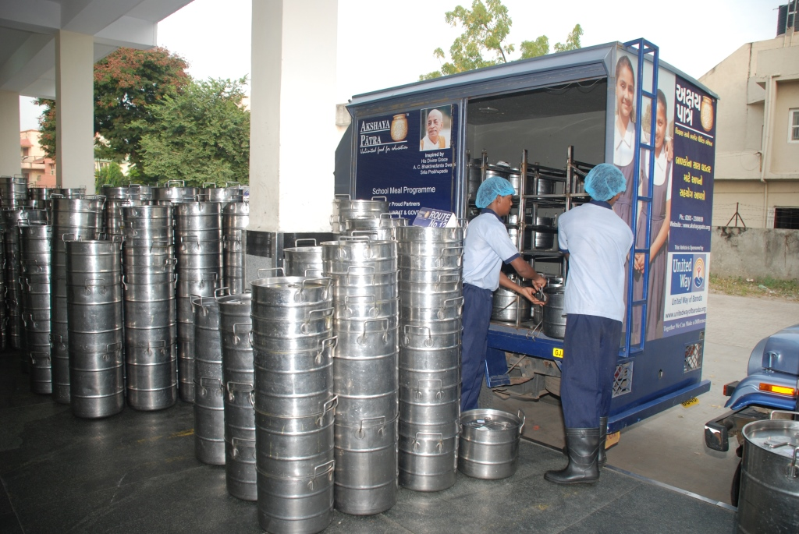
NGO PARTICIPATION

Slide 18
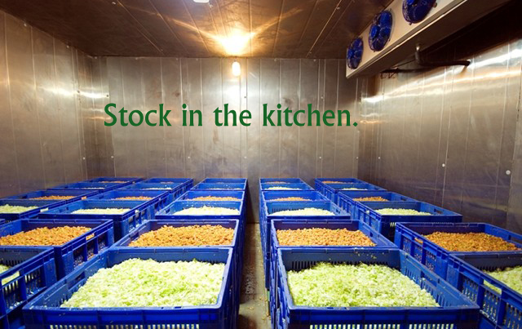

Slide 19
Website/Mobile Application for AMS and Data collection
From 01-07-2016 to 30-04-2017 data was collected through IVRSsystem, thereafter from 05-06-2017 onwards website/Mobile application is operational.
Using web services real time data transfer to NIC,Delhi and CM dash board.
URL:- https://mdm.gujarat.gov.in/
.

Slide 20
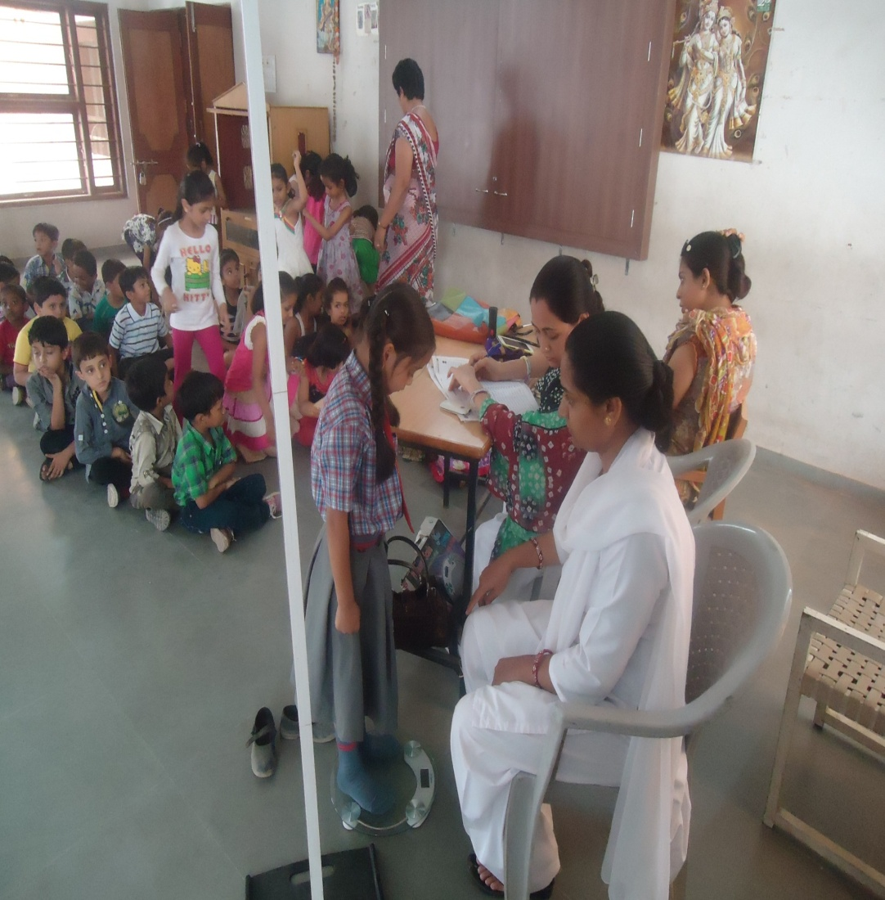
SCHOOL HEALTH PROGRAMME
Total Children:- 5761819
Total Inspected Children:- 5646582 (98%)
Child Pediatrician:- 31,260
Eye Specialist:- 58,288
Dental Surgeon:- 40,822
Skin Specialist:- 16,790
ENT Specialist:- 12,865
Other disease specialist:- 11,115
Distribution of specs without any cost:- 1,39,068

Slide 21
Progress of MDM for year 2017-18
(up to March-2018)

Slide 22
MDM Coverage
Standard | Coverage (2017-18)
 | Enrollment | Beneficiary | Coverage in %
Primary | 3574670 | 2672852 | 74.77
Upper Primary | 2187149 | 1724388 | 78.84
Total | 5761819 | 4397240 | 76.31
Approved days as per PAB Up to March-18 |  | Actual MDM given days Up to March-18
Primary | Upper Primary | Primary | Upper Primary
237 | 237 | 237 | 237

Slide 23
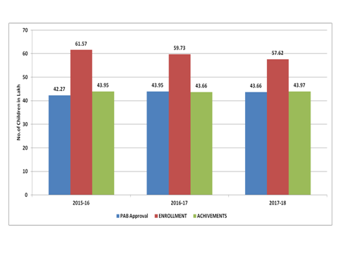
Coverage against PAB Approved Analysis during last 3 yrs

Slide 24
Coverage against PAB Approved Analysis during last 3 yrs
No. of Children in lakh

Slide 25
Inspection of MDM Centres And Coverage of MDM
Inspection of MDM centers:
During current year 43307 MDM centers are inspected and 220 samples are taken for quality check.
The coverage:
In the year 2017-18, Over all four quarter Coverage against enrollments of MDM is 76.31%

Slide 26
MDM for Std. 12 students of Model day school
Model School scheme has been launched from year 2014-15 .Total 72 model schools are in different districts of the state.
In model School mid day meals and nutritious snacks is given to the children from std. 6 to 12.
Provision is Rs. 908.17 lakhs for mid day meal and nutritious snacks in the 72 model schools.

Slide 27
Annual Work Plan & Budget
2018-19

Slide 28
Share | Budget (Rs. In Crore) | % of Budget
Central Share (60%) | 40328.24 | 45.17
Central Share (100%) | 10230.59
State Share (40%) | 26885.49 | 24.02
State Share (100%) | 34482.87 | 30.81
Total | 111927.19 | 100.00

Slide 29
Annual Work Plan & Budget: 2018-19
Component | PAB Approval for 2017-18 (Rs. in Lakh) |  |  | Proposal 2018-19 (Rs. in Lakh)
 | Central | State | Total | Central | State | Total
Cost of Food grain | 3142.23 |  | 3142.23 | 3271.34 |  | 3271.34
Cooking Cost | 30823.03 | 20513.75 | 51336.78 | 34548.5 | 23032.33 | 57580.83
Honorarium to Cook Cum Helper | 5467.86 | 3645.24 | 9113.1 | 5779.74 | 3853.16 | 9632.9
Transportation Assistance | 933.33 |  | 933.33 | 975.01 |  | 975.01
Management, Monitoring and Evaluation (MME) | 726.6 |  | 726.6 | 1337.24 |  | 1337.24
Total | 41093.05 | 24158.99 | 65252.04 | 45911.83 | 26885.49 | 72797.32
Kitchen Devices |  |  |  | 4647 |  | 4647
Kitchen-cum-Store
Total | 41093.05 | 24158.99 | 65252.04 | 50558.83 | 26885.49 | 77444.32

Slide 30
RECOMMENDATION

Slide 31
COOCK-CUM-HELPERS
In last year 2017-18 PAB we proposed for 96329 cook-cum-helper but 91131 Cook-cum-helpers was approved.
There are 96329 cook cum helpers have been actually engaged.
Hence, we have require 96329 cook cum helpers for smooth working for mid day meal scheme.
Kindly permit for 5198 cook cum helpers

Slide 32
Draught
In financial year 2016-17 draught was declared at Rajkot district in vichiya block from 24/4/2017 to 20/07/2017 and at Surendranagar district in chotila block from 24/4/2017 to 03/06/2017 in Gujarat.
Total 3050 children took benefit of Mid day Meal as well as Milk of expenditure around Rs.24.84 Lakhs.

Slide 33
New Proposal for Kitchen Devices
At present kitchen devices provided to the schools, the design of which are mostly typical and old. It is therefore buy MDM kitchen devices for schools.
The estimated cost of MDM kitchen devices with above stated facility would be approximately 15000 per unit.
It is proposed to purchase30980 MDM kitchen in the schools of MDM. The total estimated cost would be Rs.46.47 crore. If it will be shared with central and state then it can reduce the burden of state.

Slide 34
Thank You…

